Slide 1
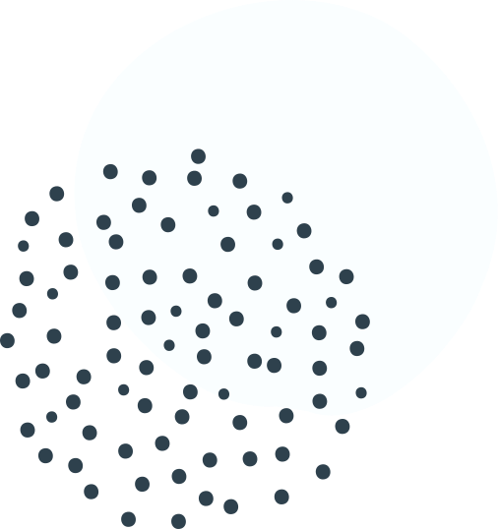
Motivation
Build as many expert variables as possible to
catch patterns of fraud transactions
Signals of card transaction fraud
Amount
Unusually high transaction amount
Transaction frequency
Infrequent recurring charges
Burst of fraud activities
Geography of transaction
Transaction happens at merchants not used before
Merchant
Transaction is made up by the merchant

Slide 2
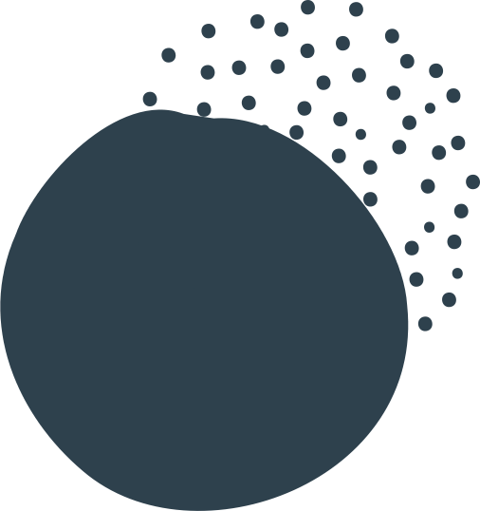
Combine related fields
Create candidate variables
Process
Cardnum
Merchnum*
Cardnum – Merchnum*
Cardnum - Zip
Cardnum - State
Look back in time to calculate values for each record
Amount variables
Days-since variables
Frequency variables
To identify unusual purchase amount
240
Average, maximum, median, total,
Actual/average, actual/maximum,
actual/median, actual/total
Cardnum, merchnum,
Cardnum – merchnum,
Cardnum – zip, Cardnum - state
Amount by/at this
Over the past
0, 1, 3, 7, 14, 30 days
To identify transaction frequency
5
Current date minus date of most recent transaction with the same
Cardnum, merchnum,
Cardnum – merchnum,
Cardnum – zip, Cardnum - state
30
To identify transaction frequency
Cardnum, merchnum,
Cardnum – merchnum,
Cardnum – zip, Cardnum - state
Number of transactions with the same
Over the past
0, 1, 3, 7, 14, 30 days

Slide 3
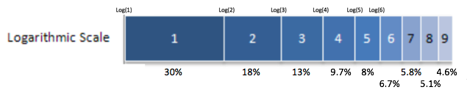
Create candidate variables
Process
24
Velocity change variables
Benford’s law variables
Risk table variables
To identify transaction frequency
Number
amount
Cardnum
Merchnum
0, 1 day
of transactions with the same
Over the past
Number
amount
Cardnum
Merchnum
of transactions with the same
Over the past
7, 14, 30 day
2
To identify fictitious transaction
Smoothed U* for
Cardnum, merchnum
To identify relationship between day of week and fraud
1
Day-of-week risk table variables
(c = 3 and nmid = 15)

